Slide 1



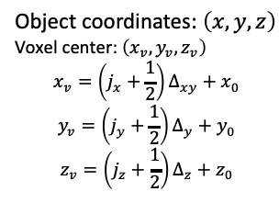


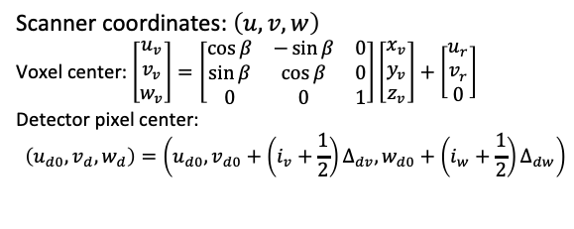


Object coordinates: $\left(x, y, z\right)$
Voxel center: $\left(x_{v},y_{v},z_{v}\right)$
$$x_{v}=\left(j_{x}+\frac{1}{2}\right)Δ_{xy}+x_{0}$$
$$y_{v}=\left(j_{y}+\frac{1}{2}\right)Δ_{y}+y_{0}$$
$$z_{v}=\left(j_{z}+\frac{1}{2}\right)Δ_{z}+z_{0}$$
Scanner coordinates: $\left(u,v,w\right)$
Voxel center: $\left[\begin{matrix}u_{v} \\ v_{v} \\ w_{v}\end{matrix}\right]=\left[\begin{matrix}\cos{β} & −\sin{β} & 0 \\ \sin{β} & \cos{β} & 0 \\ 0 & 0 & 1\end{matrix}\right]\left[\begin{matrix}x_{v} \\ y_{v} \\ z_{v}\end{matrix}\right]+\left[\begin{matrix}u_{r} \\ v_{r} \\ 0\end{matrix}\right]$
Detector pixel center:
$$\left(u_{d0}, v_{d}, w_{d}\right)=\left(u_{d0},v_{d0}+\left(i_{v}+\frac{1}{2}\right)Δ_{dv}, w_{d0}+\left(i_{w}+\frac{1}{2}\right)Δ_{dw}\right)$$
$$w$$
$$β$$
Detector Pixel
$$\text{Rotation}$$
$$\text{axis}$$
$$\left(u_{d0}, v_{d}, w_{d}\right)$$
$$\text{Voxel}$$
$$\left(u_{d0}, v_{p}, w_{p}\right)$$
$$\left(u_{v}, v_{v}, w_{v}\right)$$
$$\text{Source}$$
$$Δ_{v}$$
$$\left(u_{s}, 0,0\right)$$
$$v$$
$$u$$
$$\text{origin}$$
$$\left(u_{r},v_{r},0\right)$$
$$i_{w}$$
$$\text{(}\text{integer} \text{index}\text{)}$$
$$β$$
$$i_{v}$$
$$\text{(}\text{integer} \text{index}\text{)}$$
$$\left(u_{d0}, v_{d0}, w_{d0}\right)$$

Slide 2






$$y$$
$$α′$$
$$W_{P1}$$
$$P$$
$$Δ_{xy}$$
$$W_{V1}$$
$$V$$
$$β′$$
$$S$$
$$θ$$
$$C$$
$$x$$

Slide 3






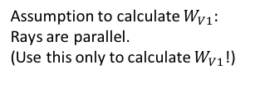
$$θ$$
$$β′$$
Assumption to calculate $W_{V1}:$
Rays are parallel.
(Use this only to calculate $W_{V1}$!)
$$α′$$
$$Δ_{xy}$$
$$W_{V1}$$
$$y$$
$$x$$

Slide 4




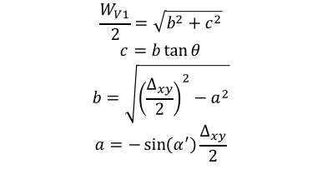






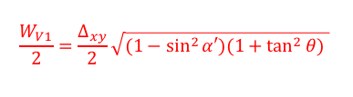


$$θ$$
$$β′$$
$$α′$$
$$a$$
$$c$$
$$\frac{W_{V1}}{2}$$
$$β′$$
$$\frac{Δ_{xy}}{2}$$
$$\frac{Δ_{xy}}{2}$$
$$θ$$
$$\frac{W_{V1}}{2}=\frac{Δ_{xy}}{2}\sqrt{(1−\sin^{2}{α′)(1+\tan^{2}{θ)}} }$$
$$b$$
$$α′$$
$$\frac{W_{V1}}{2}=\sqrt{b^{2}+c^{2}}$$
$$c=b\tan{θ}$$
$$b=\sqrt{{\left(\frac{Δ_{xy}}{2}\right)}^{2}−a^{2}}$$
$$a=−\sin\left(α^{′}\right)\frac{Δ_{xy}}{2}$$
Note: variables a, b, and c are just auxiliary variables!
$$y$$
$$x$$

Slide 5
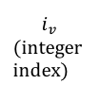




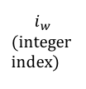



$$w$$
$$\text{Rotation}$$
$$\text{axis}$$
$$\text{Detector}$$
Object coordinates: $\left(x, y, z\right)$
Scanner coordinates: $\left(u,v,w\right)$
Voxel center: $\left(x_{v},y_{v},z_{v}\right)=\left(j_{x},j_{y},j_{z}\right)Δ_{v}+(x_{0},y_{0},z_{0})$
Voxel center: $\left[\begin{matrix}u_{v} \\ v_{v} \\ w_{v}\end{matrix}\right]=\left[\begin{matrix}\cos{β} & −\sin{β} & 0 \\ \sin{β} & \cos{β} & 0 \\ 0 & 0 & 1\end{matrix}\right]\left[\begin{matrix}x_{v} \\ y_{v} \\ z_{v}\end{matrix}\right]+\left[\begin{matrix}0 \\ v_{r} \\ 0\end{matrix}\right]$
$$β$$
Detector Pixel
$$\text{Voxel}$$
$$\left(u_{d0}, v_{d}, w_{p}\right)=$$
$$(u_{d0},v_{d0}+i_{v}Δ_{dv}, w_{d0}+i_{w}Δ_{dw})$$
$$\left(u_{v}, v_{v}, w_{v}\right)$$
$$\text{Source}$$
$$(u_{d0},0,0)$$
$$v$$
$$u$$
$$\left(u_{s}, 0,0\right)$$
$$\text{origin}$$
$$\left(0,v_{r},0\right)$$
$$i_{w}$$
$$\text{(}\text{integer} \text{index}\text{)}$$
$$β$$
$$i_{v}$$
$$\text{(}\text{integer} \text{index}\text{)}$$
$$\left(u_{d0}, v_{d0}, w_{d0}\right)$$

